Slide 1
HOC
v/s
Custom Hook

Slide 2
What is a Higher Order Component?
A Higher Order Component (HOC) is a function that takes a component and returns a new component with enhanced or additional behavior.
Component ➜ HOC ➜ Enhanced Component.
It follows the same idea as higher-order functions in JavaScript.

Slide 3
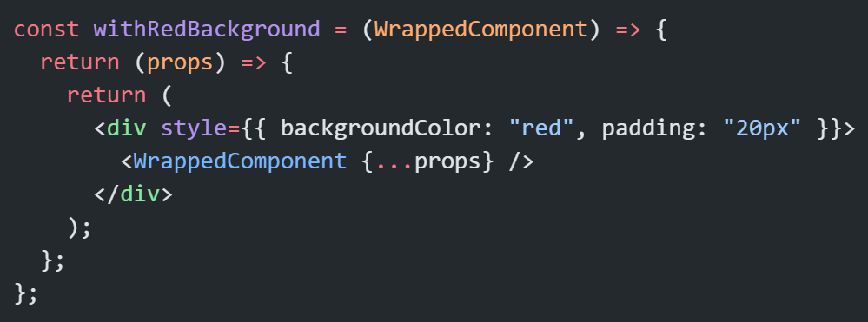
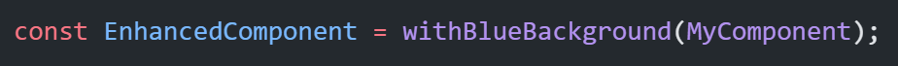
Basic Syntax of a HOC

Slide 4
What is a Custom Hook?
custom hook is a JavaScript function in React that:
starts with the word use
uses other hooks inside it
allows you to reuse logic across components
Custom hooks do NOT return JSX. They return data or functions. They help extract reusable logic, not UI.

Slide 5
Why do we use HOCs Or Custom Hook?
HOCs are used to reuse logic across multiple components without repeating code.
Common Use Cases:
Adding extra UI behavior
Authentication checks
Permission-based rendering
Data fetching
Logging or analytics
Injecting extra props
Reusing complex logic across multiple components

Slide 6
HOCs vs Custom Hooks (Modern React)
Nowadays, people prefer custom hooks, because they are:
Cleaner
Easier to reuse
Avoid wrapper hell
But HOCs are still used in many old codebases and libraries like react-redux (connect HOC).

Slide 7
Thank You

